Slide 1
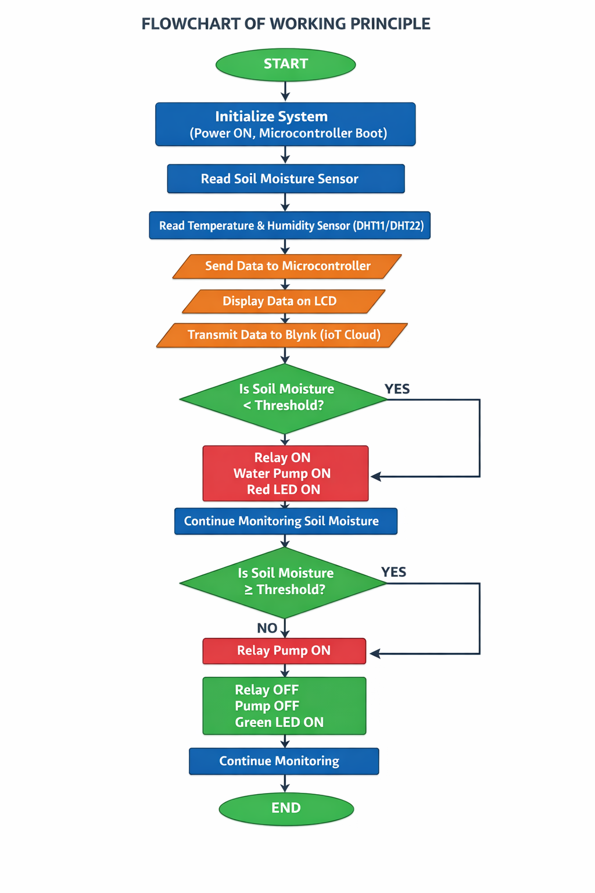
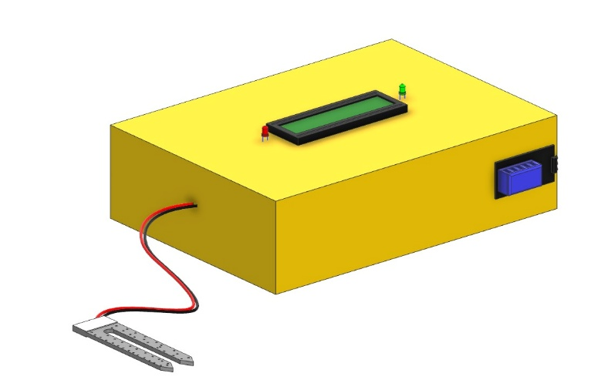
SMART IRRIGATION MONITORING SYSTEM
Project Abstract
Water scarcity and inefficient conventional irrigation practices such as flood and manual watering cause excessive water usage, uneven
distribution, and reduced crop productivity. This project presents an Advanced, Intelligent, Sustainable, and Automated Smart Irrigation
Monitoring System that integrates soil moisture, temperature and humidity sensors with an ESP32 microcontroller and the Blynk IoT platform.
The system continuously monitors soil and environmental conditions and automatically controls a water pump through a relay module, ensuring
water is supplied only when required. Real-time data is displayed on an LCD and can be viewed remotely via a mobile application, reducing
water wastage and manual labour.
Problem Statement
Traditional irrigation is largely manual or performed on fixed schedules without regard to actual soil moisture, leading to over- or under-irrigation,
poor soil health, and wasted water and labour, especially on large agricultural lands.
Need for the Project
A low-cost, automated irrigation system is needed to deliver water precisely based on real-time soil and climatic conditions, conserve water
resources, reduce manual monitoring effort, and enable farmers to track and control irrigation remotely.
Project Objectives
To design and develop an automated, IoT-based smart irrigation monitoring system.
To continuously monitor soil moisture, temperature, and humidity in real time.
To automatically control the water pump based on predefined moisture thresholds.
To enable remote monitoring and control through the Blynk mobile/web platform.
System Requirements
Hardware
ESP32 Wi-Fi microcontroller, resistive soil moisture sensor, DHT11 temperature & humidity sensor, 5v relay module, 12V DC water pump, 16×2 I2C LCD display, Green & red status LEDs, connecting wires, and a 12V power supply.
Software
Arduino IDE for firmware development, Embedded C/C++ for the ESP32, and the Blynk IoT platform for cloud connectivity and mobile/web monitoring.
Methodology / Workflow
Literature Study & Requirement Analysis → Hardware & Sensor Selection → Circuit Assembly → Firmware Programming (Arduino IDE) →
Sensor Integration → Wi-Fi / Blynk Integration → Testing (Dry & Wet Soil) → Performance Evaluation.
System Architecture
Project Development Process
Problem Identification → Requirement Analysis → Literature Review → Component Selection → Hardware Assembly → Programming & Sensor
Integration → IoT (Blynk) Integration → Testing & Validation → Final Prototype.
Implementation
The system was implemented by interfacing a soil moisture sensor and DHT11 sensor with an ESP32 microcontroller. Sensor readings are
processed in real time; when soil moisture falls below a predefined threshold, the ESP32 energizes a relay that switches ON the 12V DC water
pump and the Red LED, while the Green LED indicates a sufficiently moist, irrigation-not-required state. All readings and pump status are shown
on a 16×2 LCD and streamed to the Blynk app for remote monitoring.
Algorithms / Models Used
Algorithm 1 – Soil Moisture Threshold Algorithm: Continuously reads the analog soil moisture value and compares it against a predefined threshold to decide the pump ON/OFF state.
Algorithm 2 – Irrigation Control & Feedback Algorithm: Combines soil moisture, temperature, and humidity readings to drive the relay, Red/Green LED indicators, LCD display, and Blynk cloud updates in a continuous monitoring loop.
Dataset / Input Data
Real-time soil moisture readings (0–100%), temperature (0–50°C), and relative humidity (20–90% RH) collected from the sensors during dry-
soil and wet-soil test trials were used to trigger pump control decisions and to evaluate the accuracy and responsiveness of the system.
Experimental Setup
The prototype — an ESP32 microcontroller, soil moisture sensor inserted into dry and wet soil sample containers, DHT11 sensor, relay
controlled 12V DC pump, and 16×2 I2C LCD — was tested under normal lab conditions. Sensor data was logged and cross-verified against
the Blynk mobile dashboard to evaluate system performance.
Results
Testing and Validation
Challenges Encountered
Challenge 1: Achieving a consistent soil-moisture threshold across varying soil types.
Challenge 2: Maintaining stable Wi-Fi/Blynk connectivity for continuous remote monitoring
Solutions Implemented
Solution 1: Calibrated threshold values through repeated dry- and wet-soil test trials.
Solution 2: Optimized ESP32 Wi-Fi firmware and used a stable power supply for reliable IoT communication.
Innovation / Novel Features.
A low-cost (~₹1,480), closed-loop automated irrigation solution combining soil-moisture and climate sensing with relay-driven pump control,
dual LED status indication, and Blynk-based IoT remote monitoring and control — making precision irrigation accessible to small-scale
farmers.
Applications
Agricultural fields for automatic irrigation
Greenhouses and polyhouse farming
Home gardens and smart gardening systems
Nurseries and landscaping / lawn irrigation
Future Scope
Future enhancements include pH, nutrient, and rain sensors; weather-forecast-based scheduling; wireless sensor networks for large fields;
multi-crop irrigation customization; capacitive moisture sensors for durability; and an integrated automatic fertilizer dosing system.
Project Outcomes
The project successfully delivered a validated, automated smart irrigation prototype that reduces water wastage and manual labour through
real-time IoT-based monitoring — suitable for small-scale agricultural fields, home gardens, and greenhouse environments.
Skills Acquired
Technical Skill: Embedded Systems, ESP32 Programming, Sensor Interfacing, IoT (Blynk) Integration, CAD Modeling.
Soft Skill: Teamwork, Problem Solving, Field Research, Technical Documentation.
Module | Result
Prototype Development | Successfully built a working IoT-based irrigation prototype
Soil Moisture Sensing | Accurately distinguished dry vs. wet soil conditions
Pump Automation | Relay-controlled pump switched ON/OFF correctly at threshold
IoT Monitoring | Real-time sensor and status data streamed to Blynk successfully
Metric | Target Performance
Soil Moisture Detection | Accurate dry / wet classification
Pump Response Time | Quick, automatic activation
Temp. & Humidity Monitoring | Continuous, accurate readings
Remote Monitoring (Blynk) | Real-time data availability
System Cost | Low (~₹1,480 prototype)
References
K. Dwivedi, A. Misra, and S. Kumar, "IoT Based Smart Irrigation System Using ESP32," Int. J. Adv. Res. Comput. Sci. Softw. Eng., 2023.
R. Singh and P. Verma, "Automated Irrigation System using Soil Moisture Sensor and Blynk IoT Platform," J. Agric. Eng., 2022.
ESP32 Technical Reference Manual, Espressif Systems; DHT11 Sensor Datasheet; Blynk IoT Platform Documentation.
Acknowledgements
Department of Mechanical Engineering, Knowledge Institute of Technology, Salem.
Our Project Guide and Team Members for their valuable guidance and continuous support.
Contact information
Department of Mechanical Engineering, Knowledge Institute of Technology, Salem
Email: 2k23me013@kiot.ac.in | www.kiot.ac.in
[Insert QR Code]
QR Code — Project Report (PDF) | Source Code Repository | Demonstration Video

